Slide 1
Addressing Modes
• Instruction
– Op-code
– Operand
• Addressing mode indicates a way of locating data
or operands.
– Any instruction may belong to one or more addressing modes
– Some instructions may not belong to any of the addressing modes

Slide 2
Addressing Modes
• Data-Addressing Modes
• Program Memory-Addressing Modes
• Stack Memory-Addressing Modes

Slide 3
Addressing Modes
Immediate: The data is either 8 bits or 16 bits long and is part of the instruction
Example
– MOV AX,0001H
– MOV CX,0045H
– MOV BL,08H
– MOV AH,BFH

Slide 4
Direct: The 16-bit effective address of the
data is part of the instruction
• Example:
– MOV AX, [5000H]
– ADD AX, [1000H]

Slide 5
Register addressing: The datum is in the register that is specified by the instruction. For a 16-bit operand, a register may be AX, BX, CX, DX,SI,DI,SP or BP. For an 8 bit operand a register may be AL, AH, BL, BH, CL, CH, DL, DH.
Example :
MOV AX,BX
ADD AL, BL

Slide 6
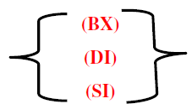

Register Indirect: The effective address of the data is in the base register BX or an index register that is specified by the instruction
Example:
MOV AX, [BX]
MOV AX,[SI]

Slide 7
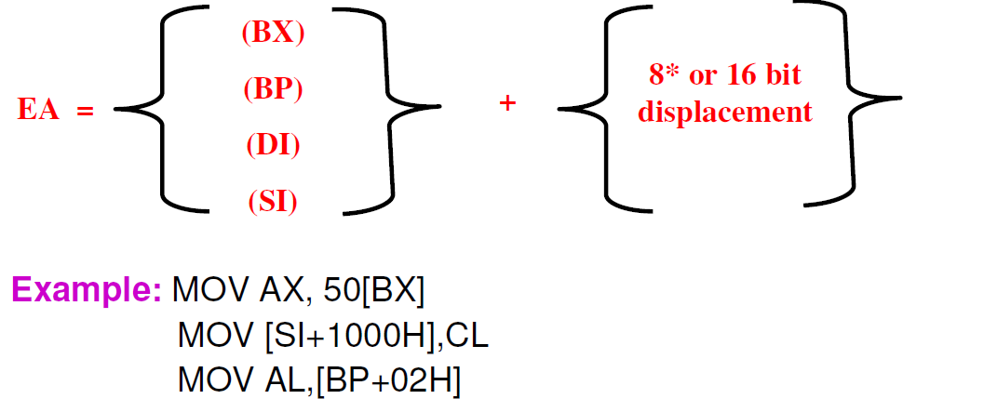
Register Relative: The effective address is the sum of an 8 or 16 bit displacement and the contents of a base register or an index register

Slide 8
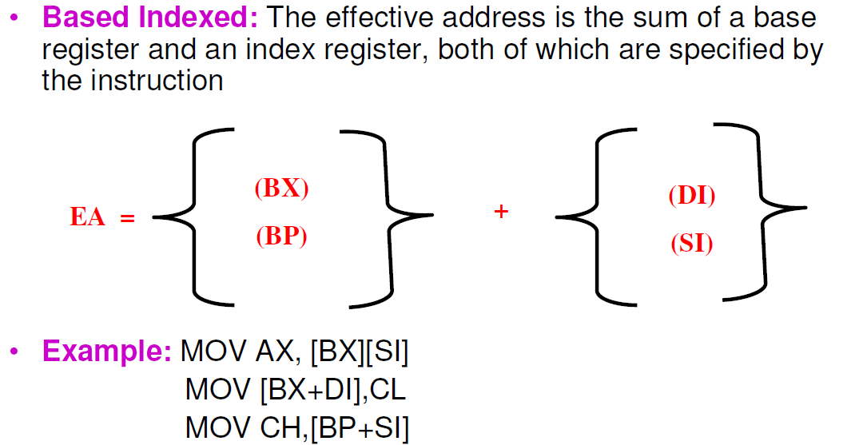

Slide 9
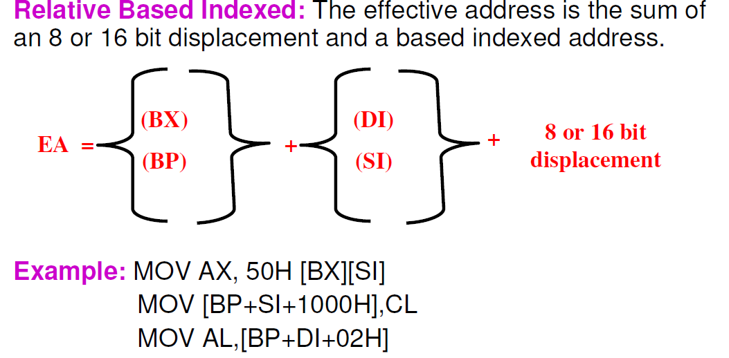

Slide 10
Example
If (BX)=0158 (DI)=10A5 Displacement=1B57
(DS)=2100 and DS is used as the segment register, then the effective and physical address produced by these quantities and the various addressing modes would be
Direct: EA=_______ PA=______
Register indirect assuming register BX:EA=___ PA=_____
Register relative assuming register BX:EA=__ PA=______
Based indexed assuming BX and DI:EA=____ PA=______
Relative based indexed assuming BX and DI:EA=______ PA=______

